Slide 1
LCCC 2018 VBS
July 23-27

Slide 3
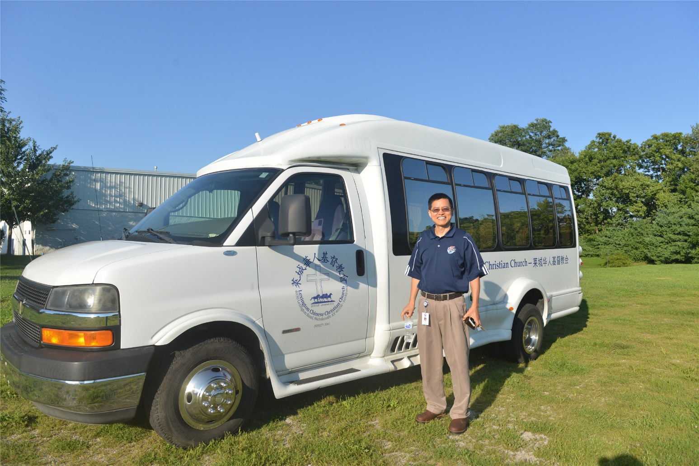
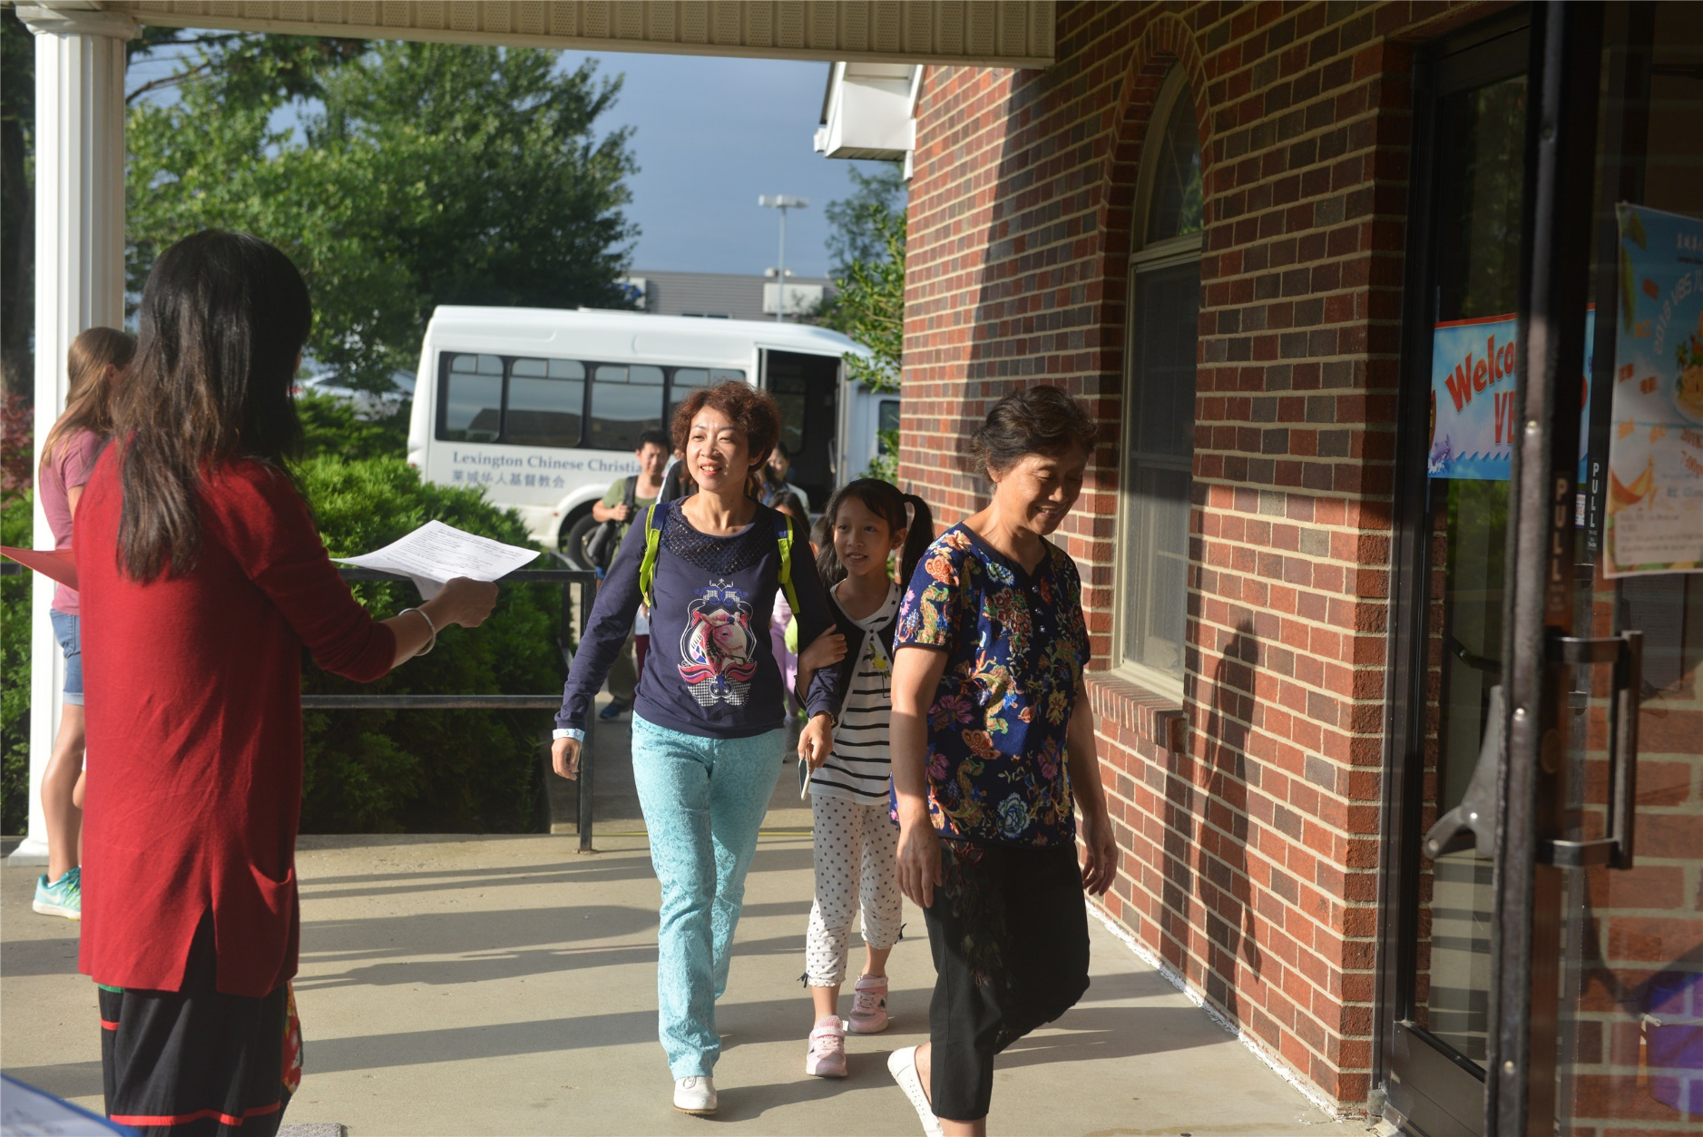
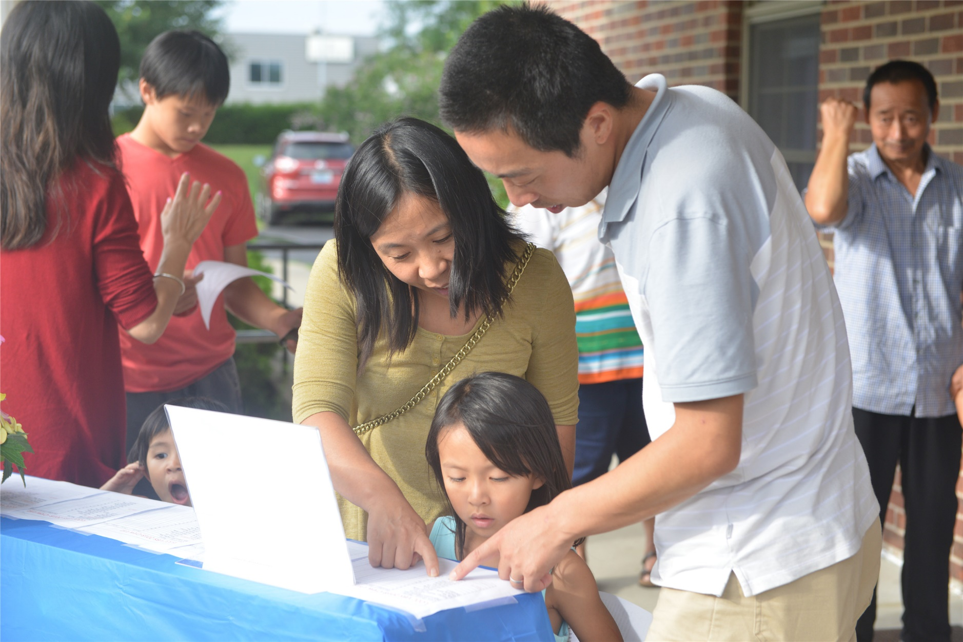
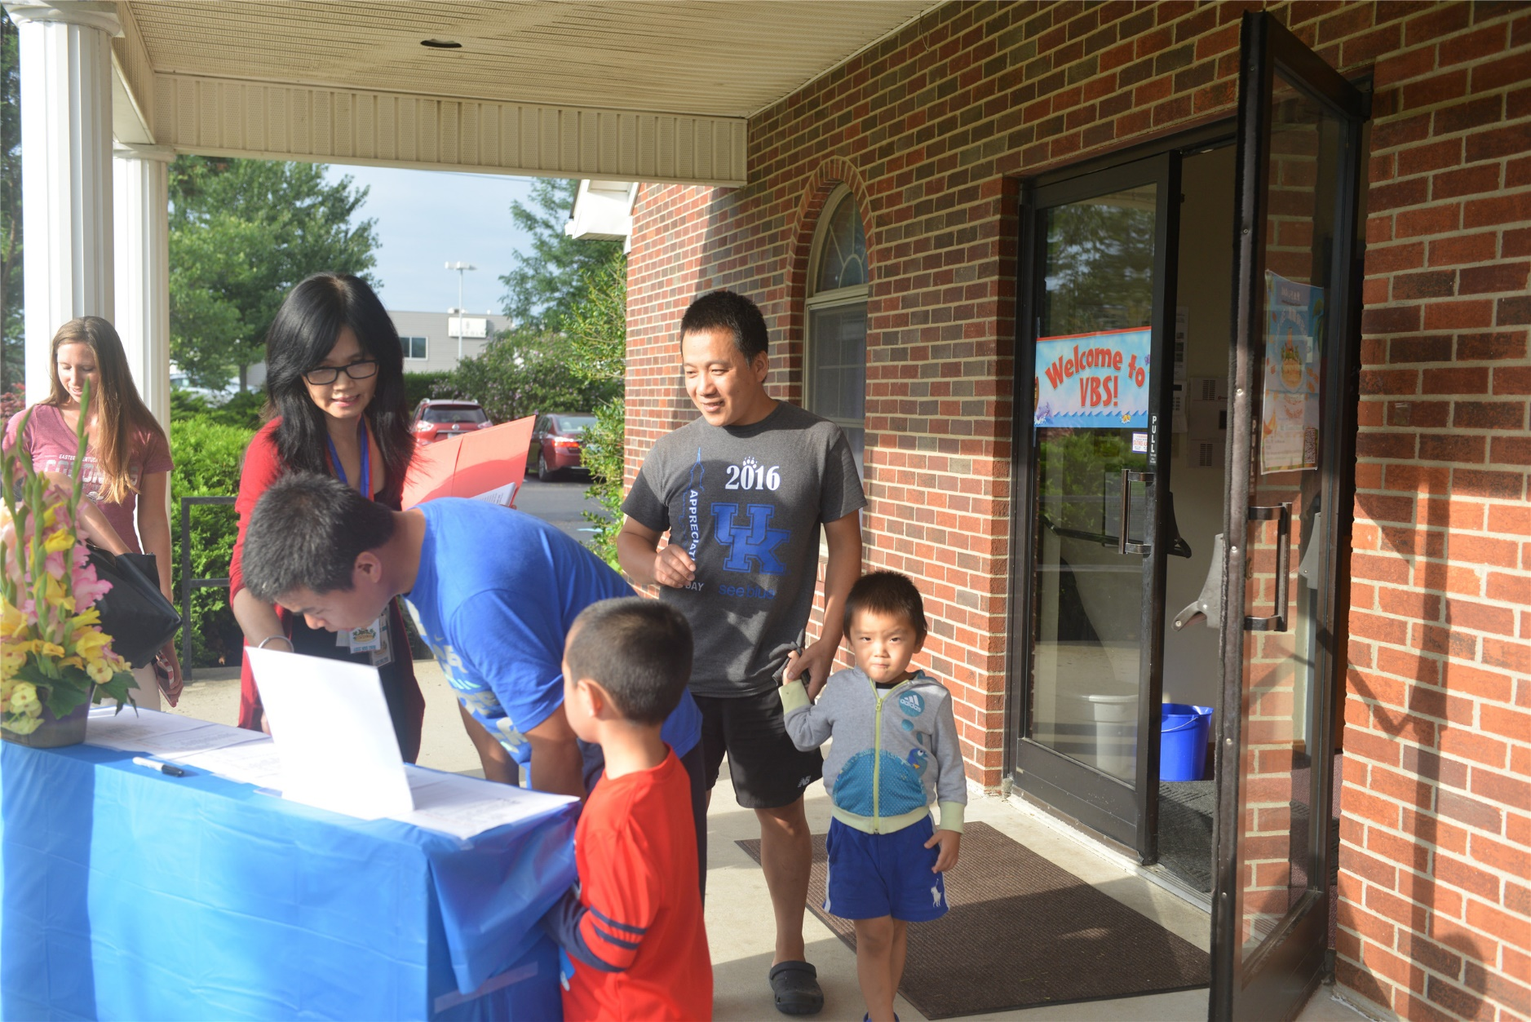
Welcome

Slide 4
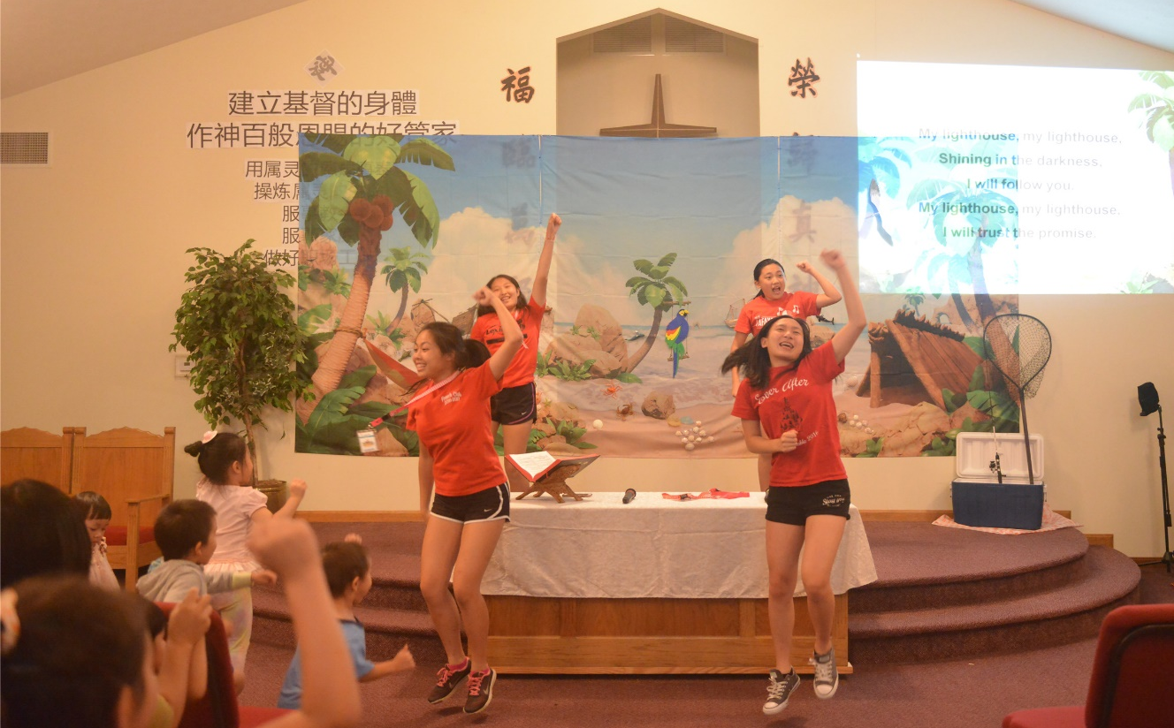
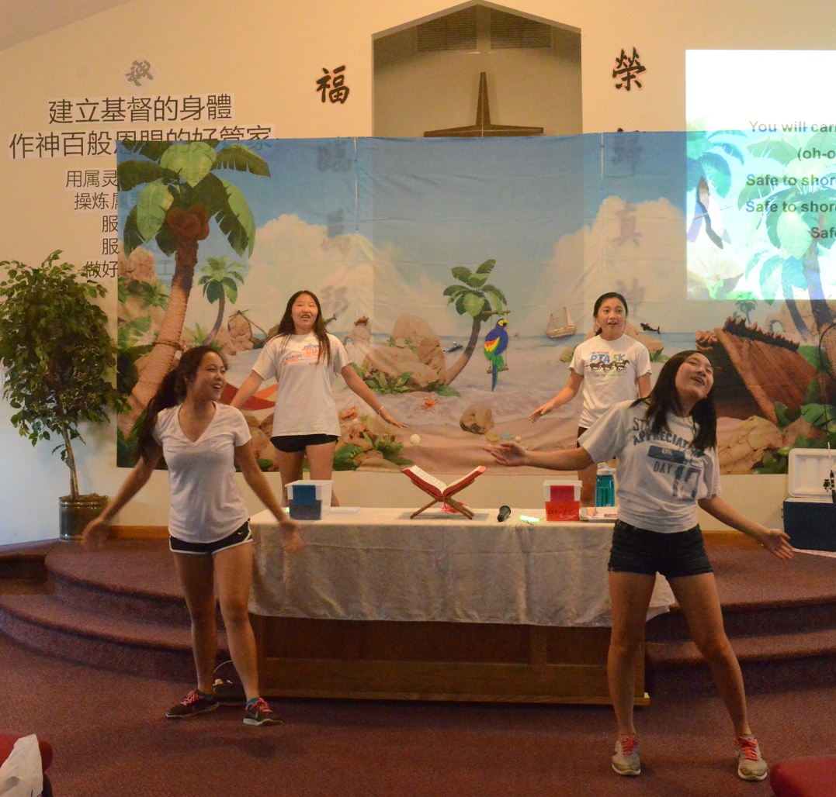
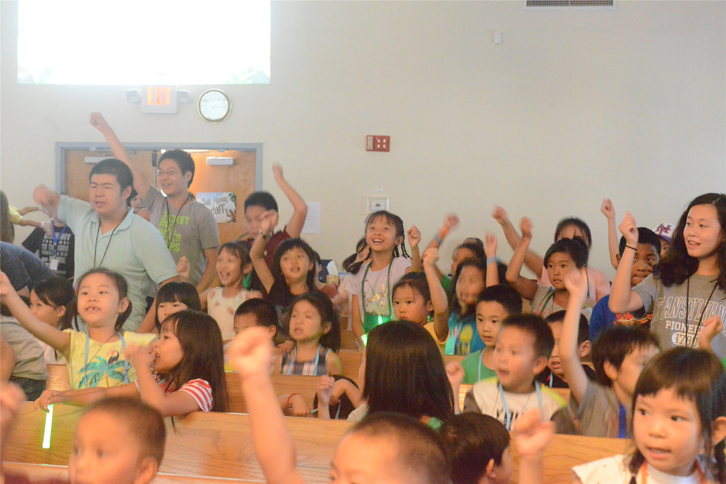
Worship

Slide 5
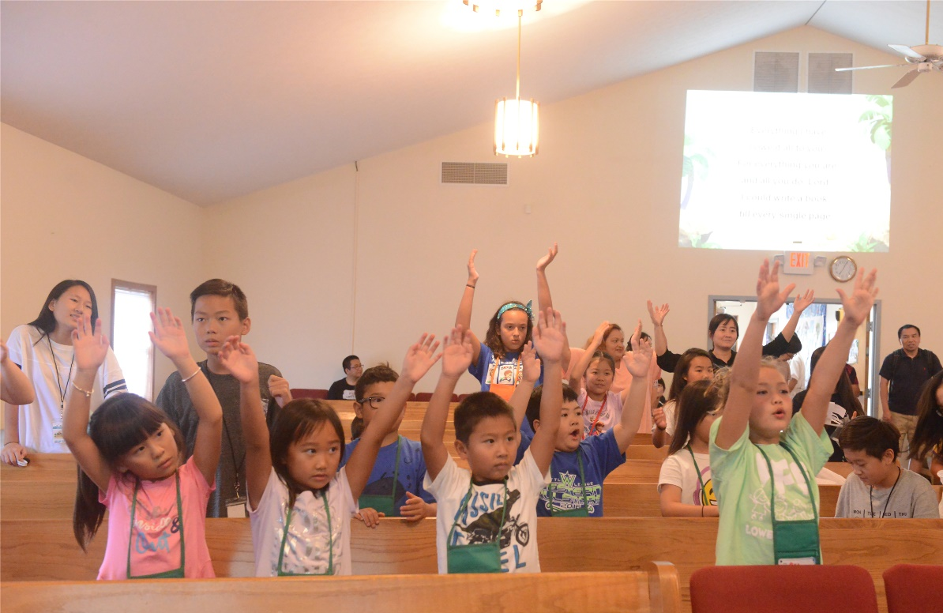
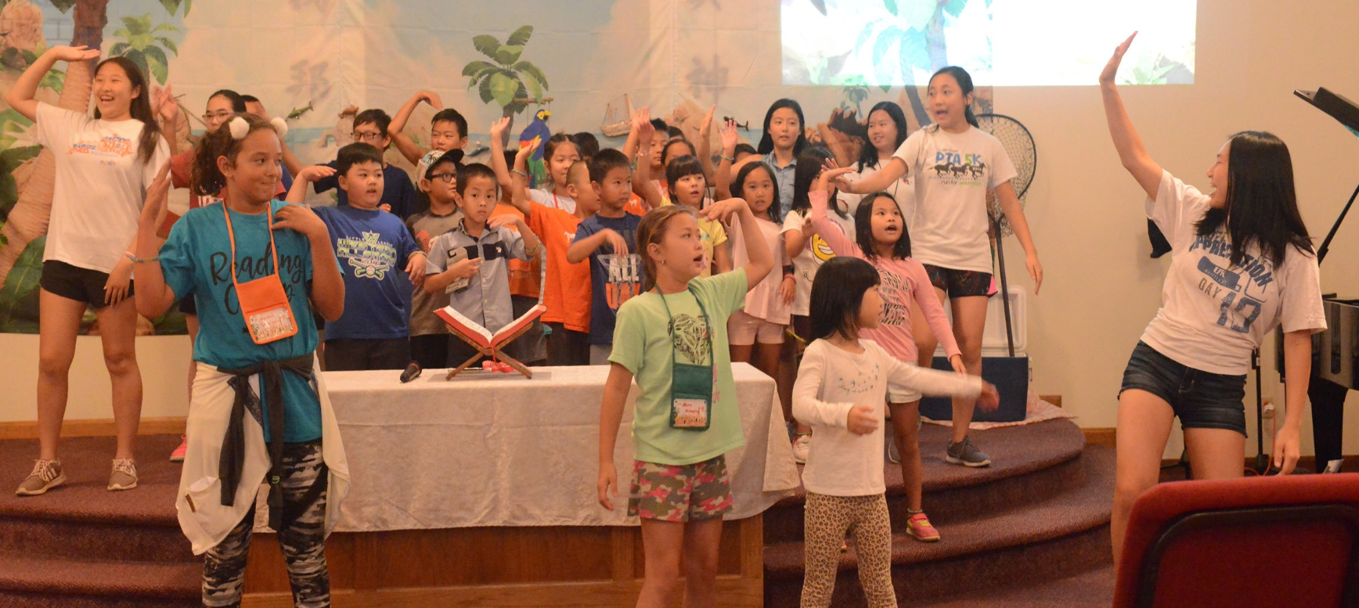
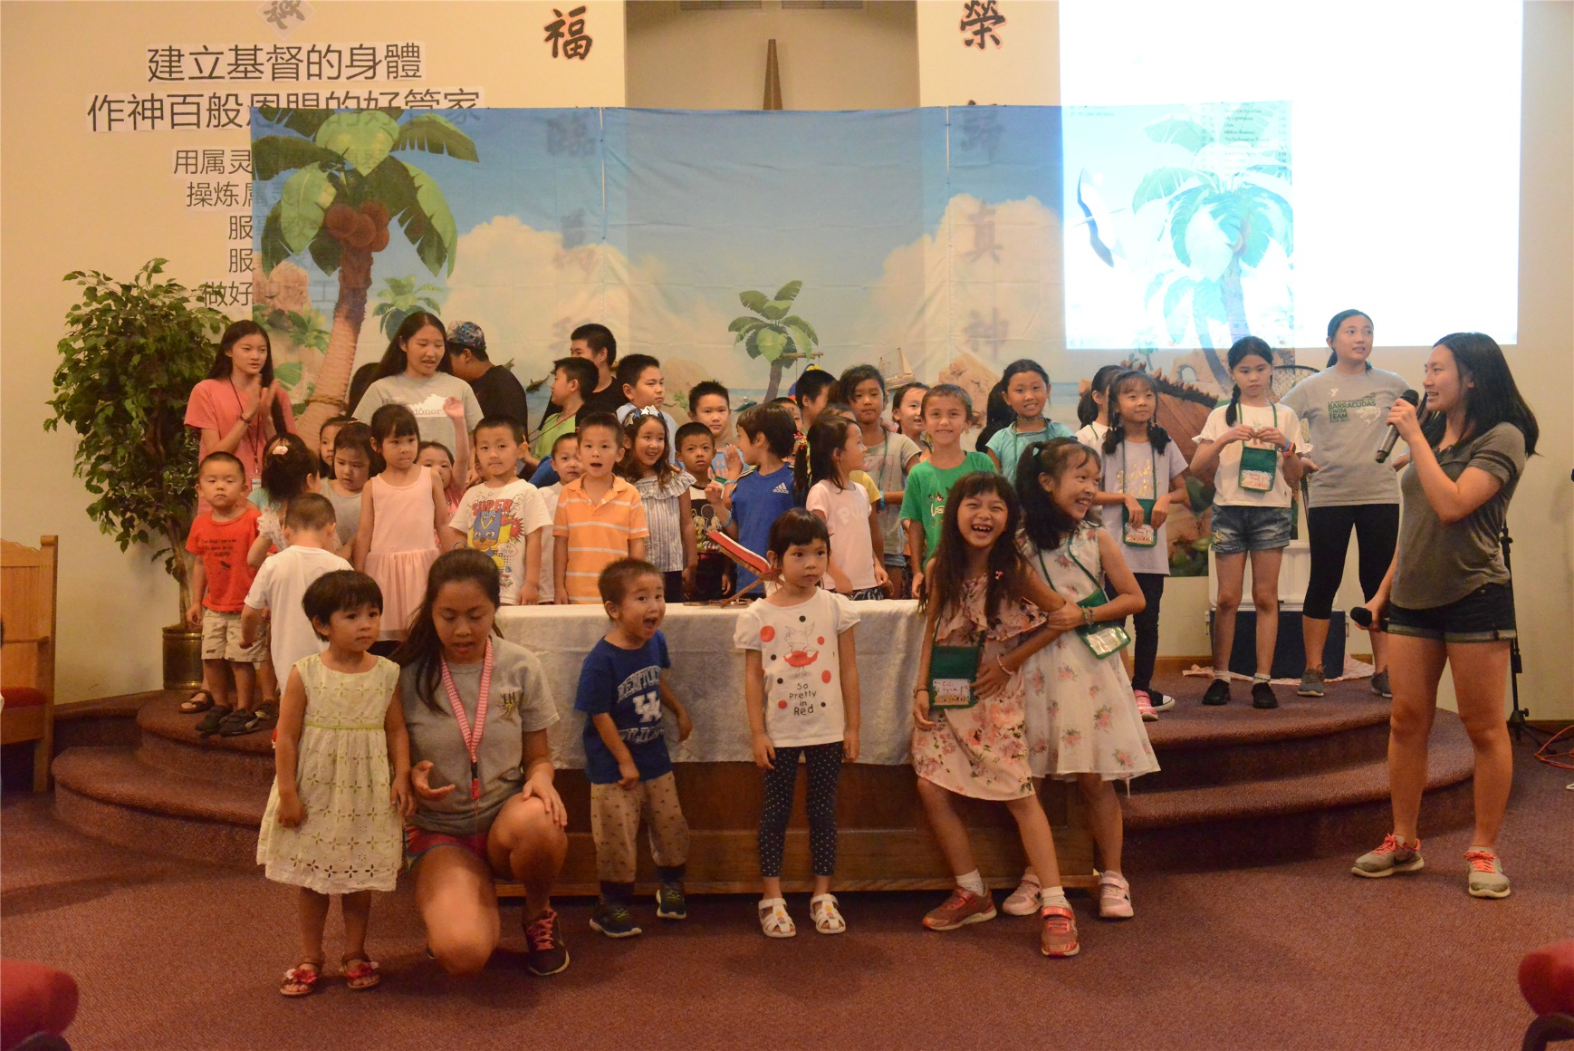
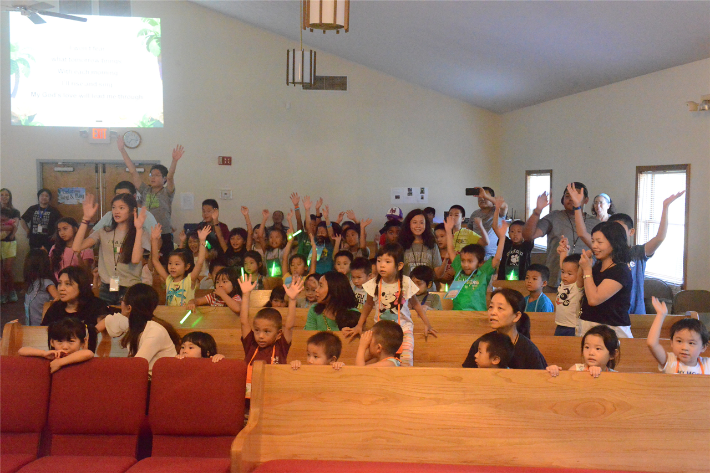

Slide 6
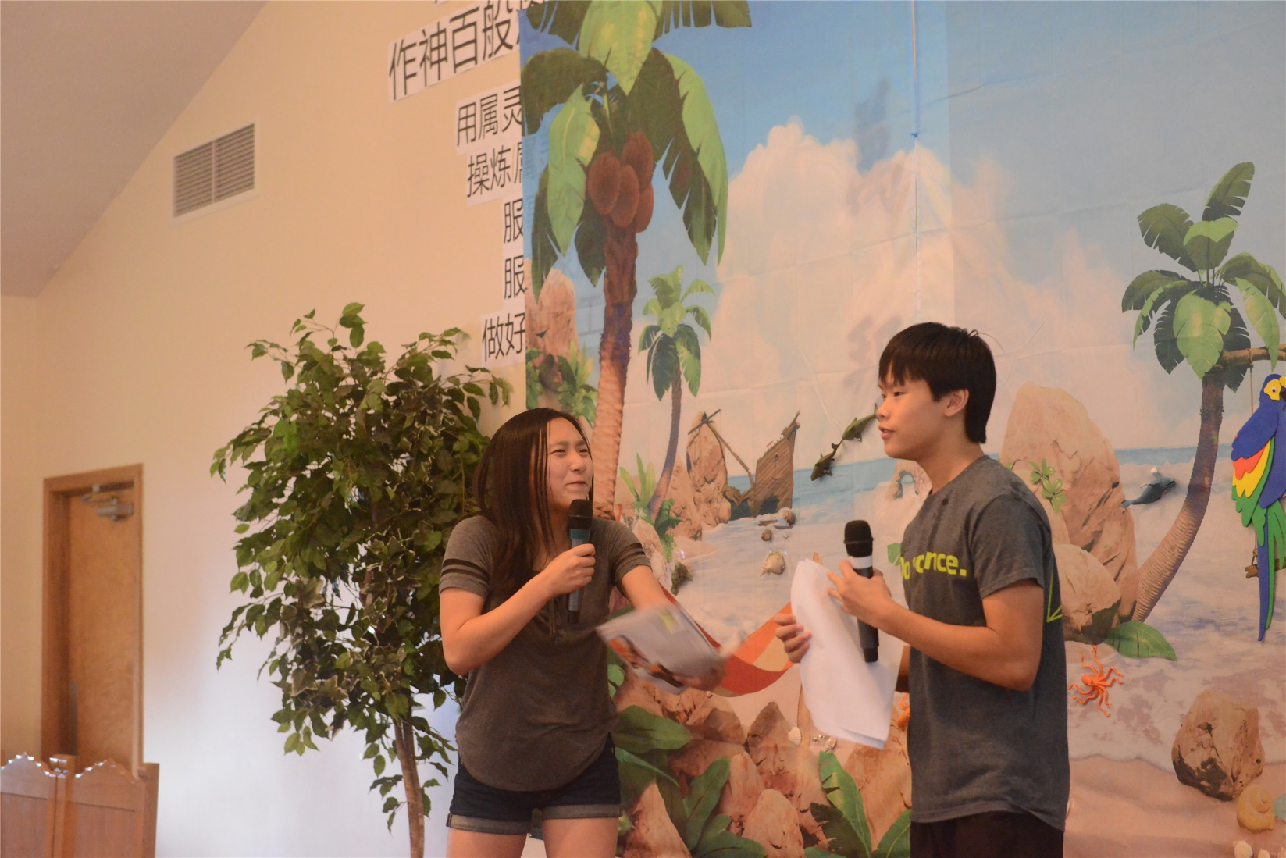
FUNNY STORY

Slide 7
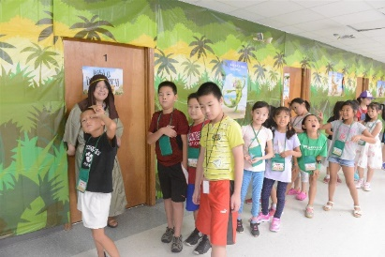
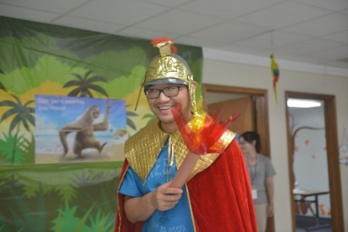
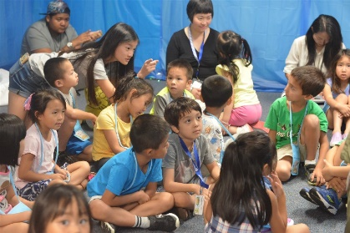
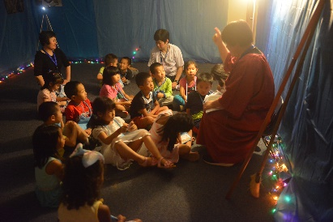
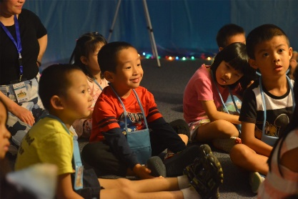
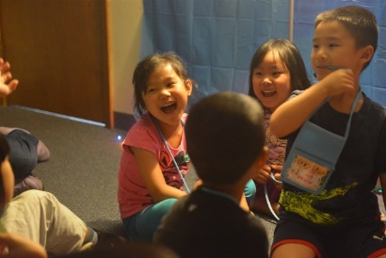
BIBLE
Discovery So Much Fun

Slide 8
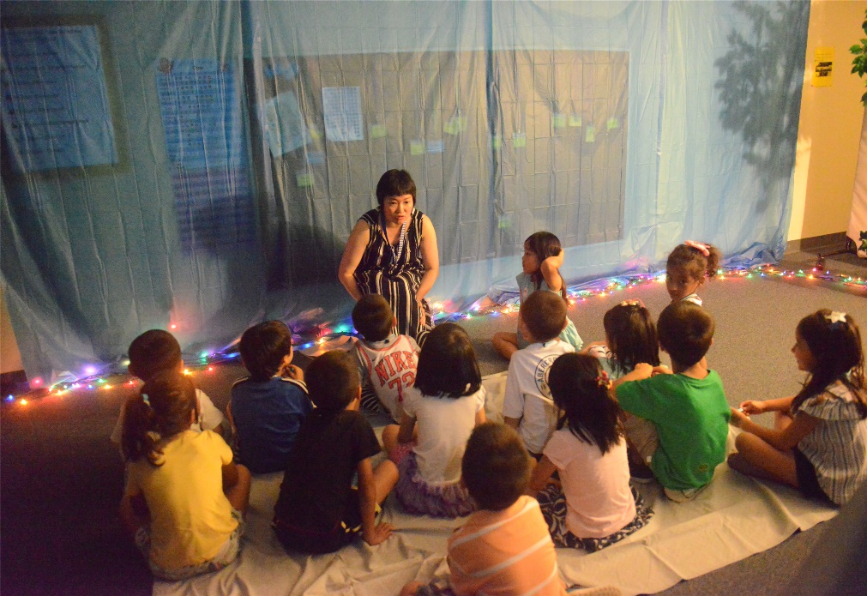
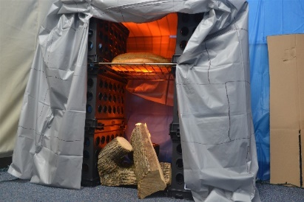
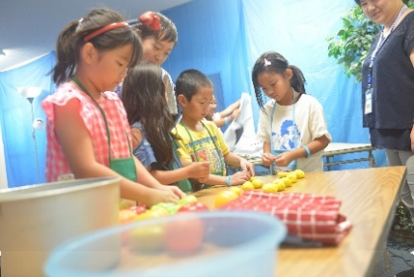
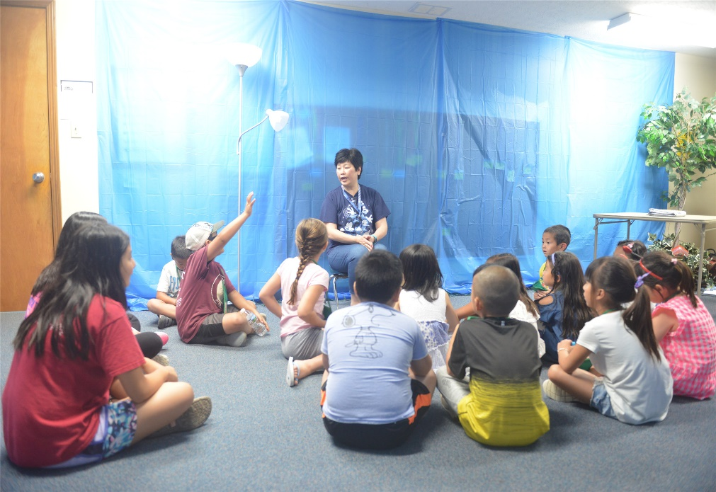
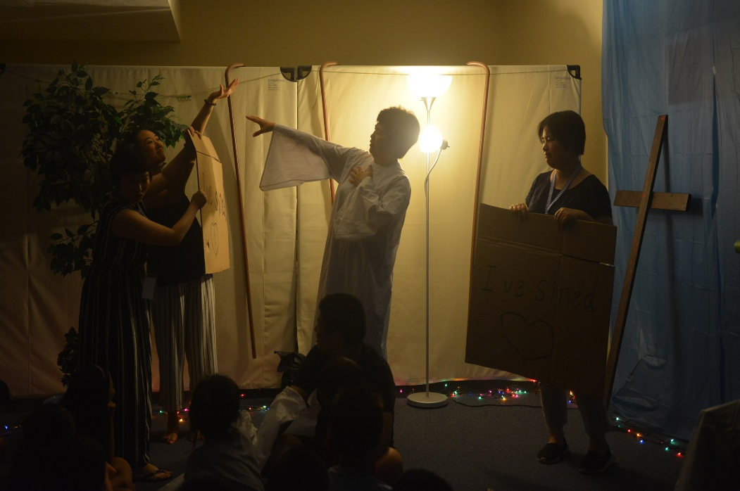
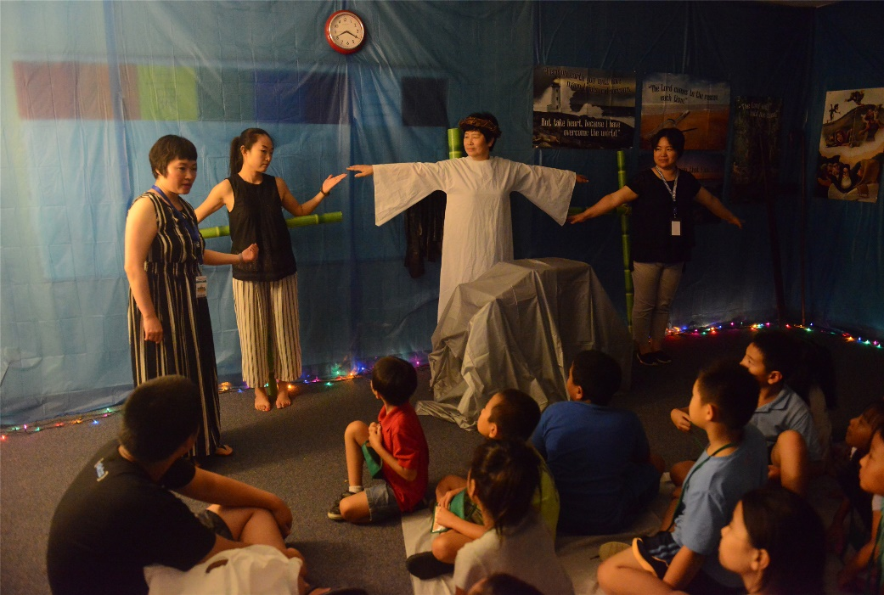
BIBLE
Discovery So Much Fun

Slide 9
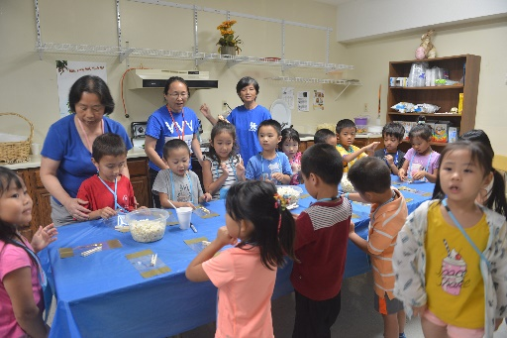
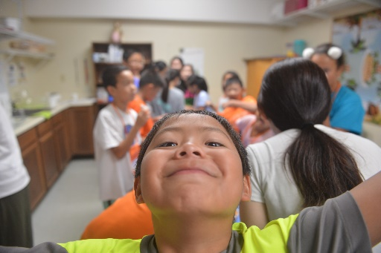
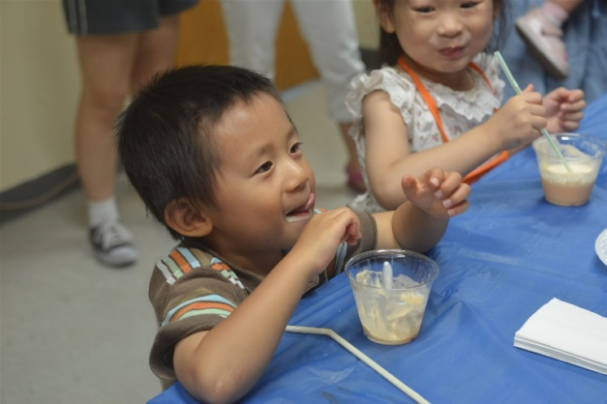
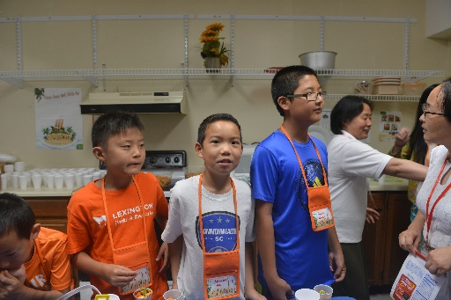
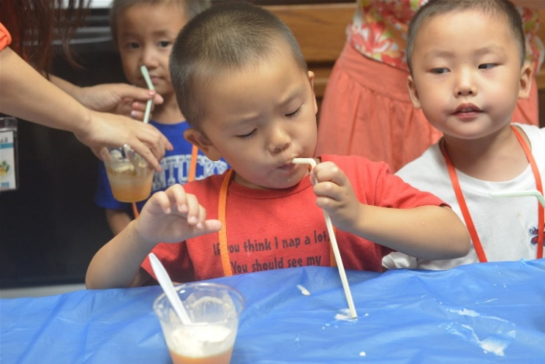
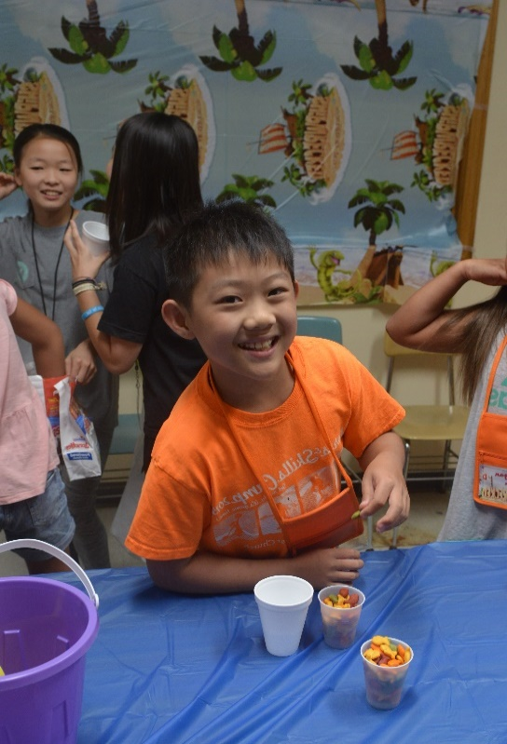
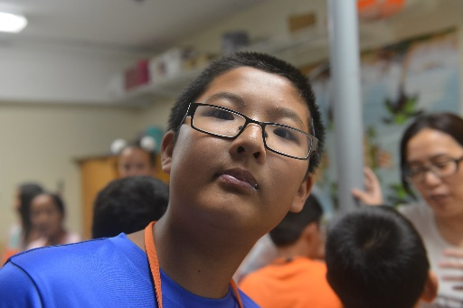
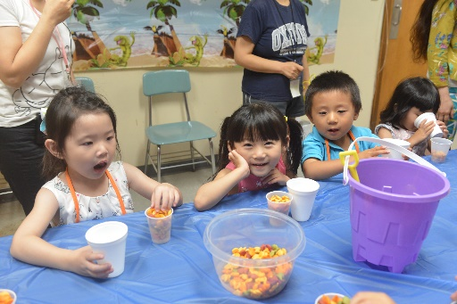
SNACK Time

Slide 10
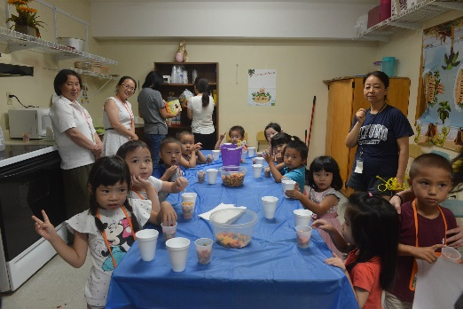
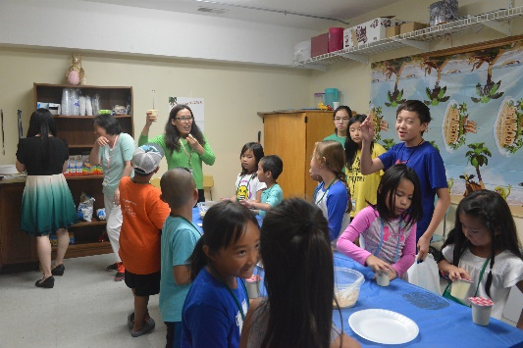
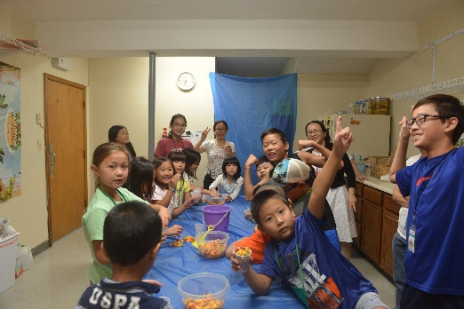
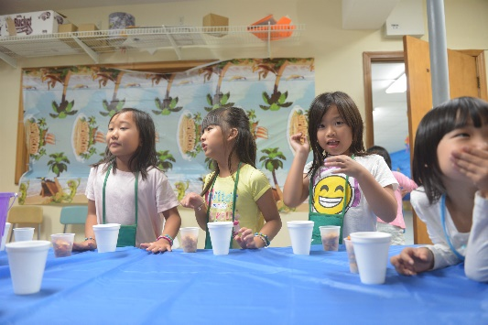
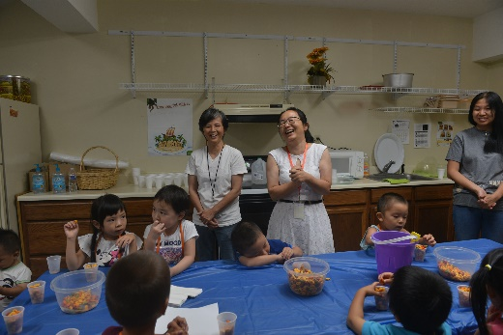
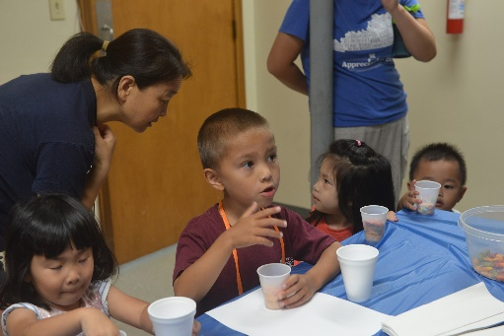
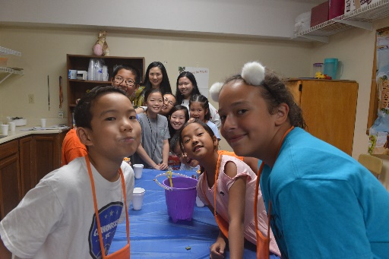
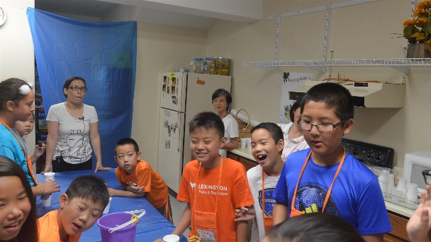
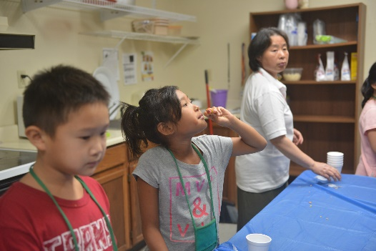
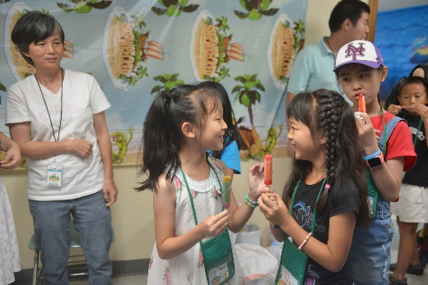
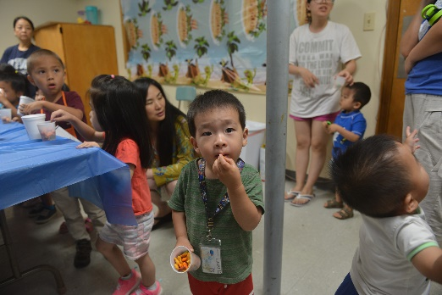
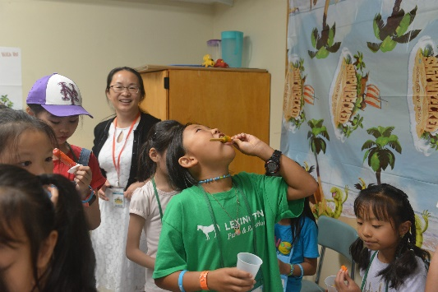

Slide 11
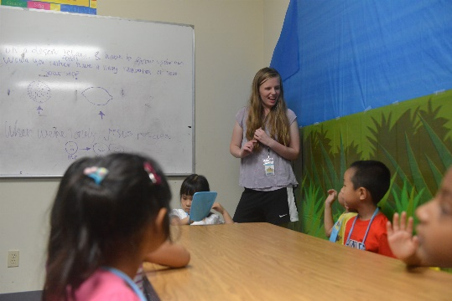
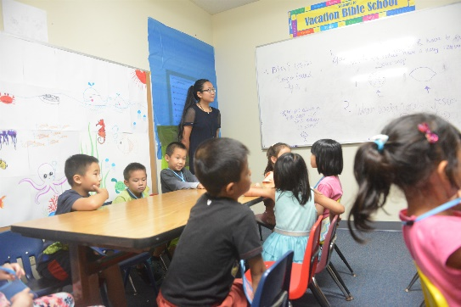
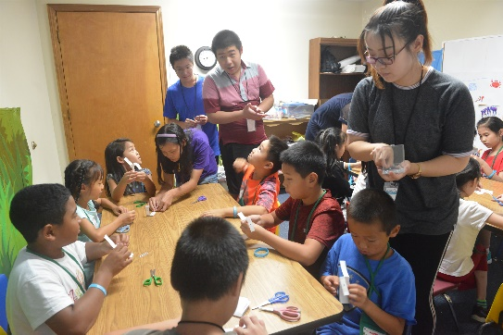
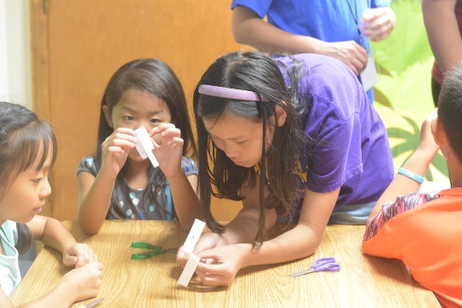
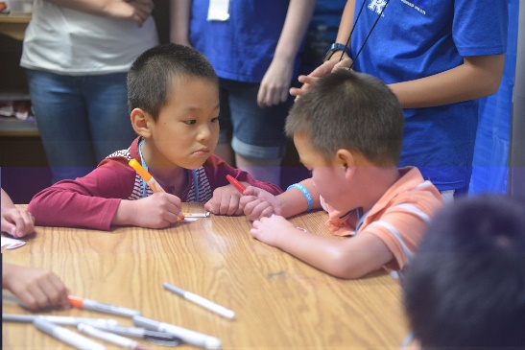
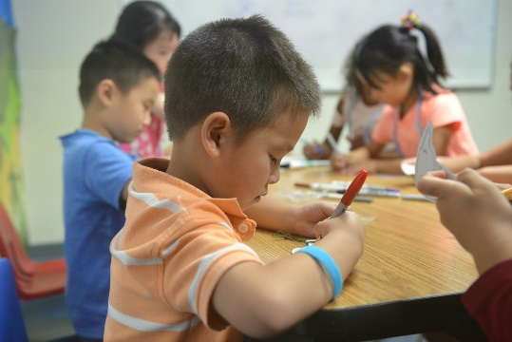
Fun
Crafts
Notes:
FUNSCRAF

Slide 13
Video Show

Slide 14
Wild game
Notes:
WILD GAME

Slide 15
Notes:
WILD GAME

Slide 16
Notes:
WILD GAME

Slide 17
Notes:
KID VIDEO

Slide 28
LCCC * VBS 2018 -Teacher and Helper assignment list
*COORDINATOR: Christa Bingham, Xiu Xu
*LEADER OF CREW LEADERS and COIN WAR: Aaron Lin
*SING AND PLAY: Sydney Sun,Mckenna Sun, Kaiqi Wang , Angie Xiao
*BIBLE ADVENTURE: Teacher: Nancy Lau, Jane Xu , Qiulin Qin , Ni Wang, Chunling Niu
Helper: Vickey Dai
*FUN CRAFTS: Jie Zhang, Kara Hucaby ,Jilie Fan
*WILD GAMES: Brian Zhu ,Nathan Zhu, Koen Lin , William He, Vivian Luo, Kevin Liu
*Video Shows: Meg Yao, Jillian Zhu
*DELICIOUS SNACKS: Hongli Huang, Meirong Wang, Haiyan Wu, Guihua Jin , Yajuan Liu, Lam Chon
*DECORATION: Diane Ng, Philip /Daisy Wong and others
*DAILY DINNER: Judy Kan
*SOUND SYSTEM: Alan Luo
*PICTURE AND VIDEOTAPING: Haifeng Chen
*PARENTS VIDEO/DISCUSSION: Hong Lin, Mingqiang Yu
*Preschool class Teacher: Lily Ma, Gaofeng Xiong , Dandan Li
*CREW LEADERS: Celina Luo, Emily Xiao, Isabel Yi, Jason Tang, Jacob Tang , Grace Yi , Sean Accius, Miranda Ma, Dannie Yang , Ethan Tai, Lele Orr, Logan Liu, Caleb Song, Keifer Lin, Sarah Lin, Christina Lin, Elizabeth Turner
*Bus Driver: Wenping Ma, Haining Zhu, Qiang He, Shenghua Fan, Gefei Wu

Slide 29
THE END

